Slide 1
Someone Got Power BI in My Teams!
Technical level: 200
Meagan Longoria @mmarie
Consultant
Denny Cherry & Associates

Slide 2

Notes:
https://www.youtube.com/watch?v=O7oD_oX-Gio

Slide 3



Who Am I?
Meagan Longoria
BI Consultant, Denny Cherry & Associates
Microsoft Data Platform MVP
DataSavvy.Me
@mmarie

Slide 4
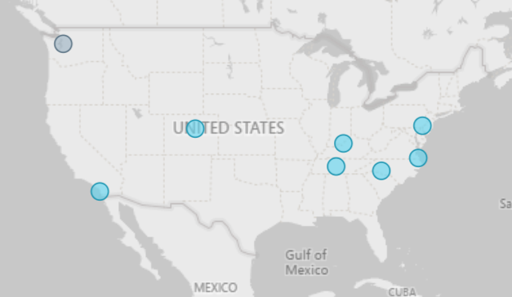
I am a Prolific Teams User
Honorary Mention
Me
John
Joey
Denny & Kris
Kerry
Monica
Peter

Slide 5
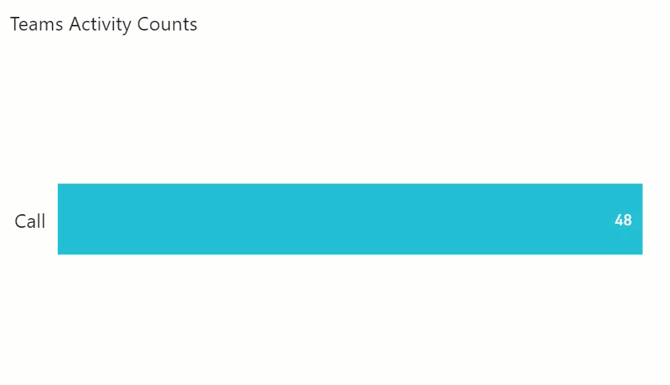
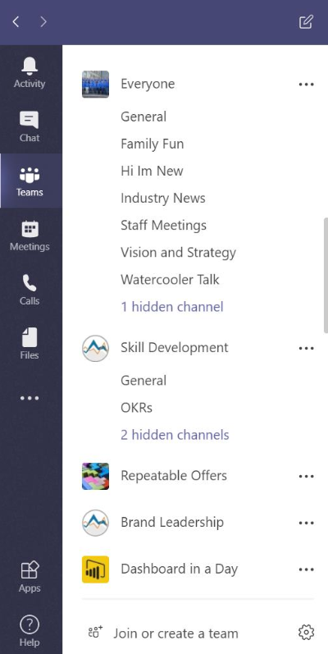
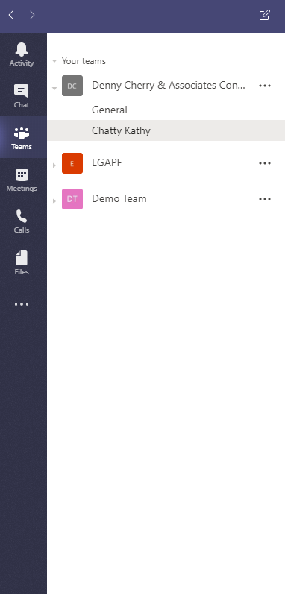

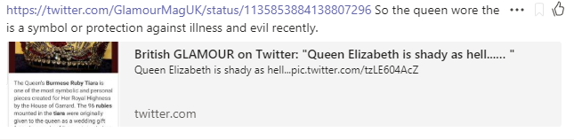
Organizational Usage Style
Previous Company
Current Company
Teams Activity Counts – Last 30 Days
Client

Slide 6
What Are We Doing Here?
Teams
Power BI reports
Put them together

Slide 7
Anatomy of a Team

Slide 8
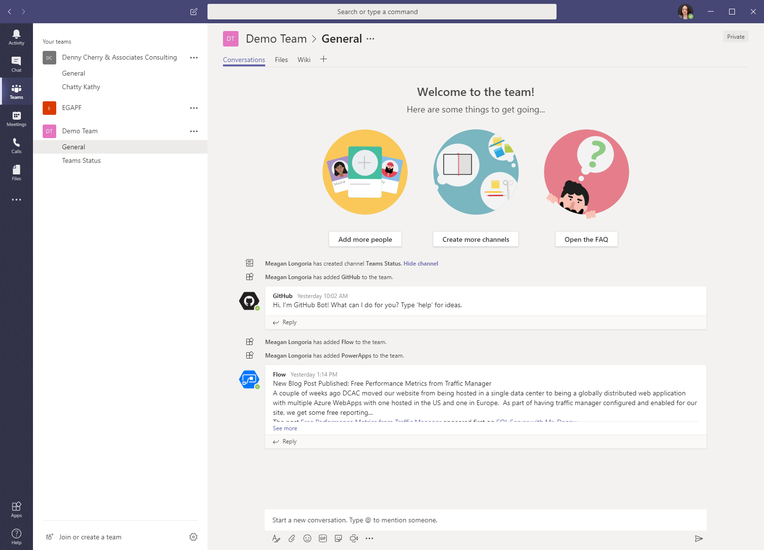
Anatomy of a Team

Slide 9
Anatomy of a Team
Team
Channel

Slide 10
Anatomy of a Team
Conversations
Files
Notes

Slide 11
Anatomy of a Team
More apps!

Slide 12
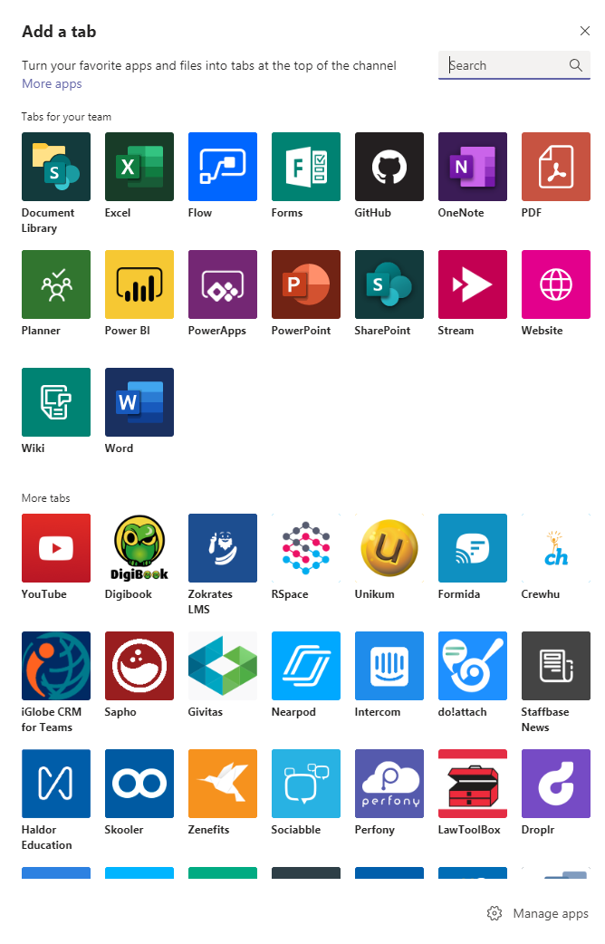
Anatomy of a Team
Power BI

Slide 13
Anatomy of A Power BI Report

Slide 14


Inside a Power BI Report
PBIX
Report
Queries
Relationships
Source Data
Dataset
Calculations

Slide 15
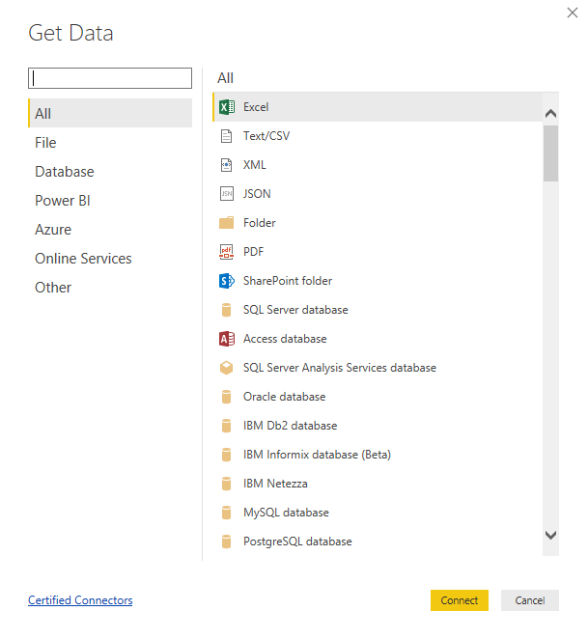
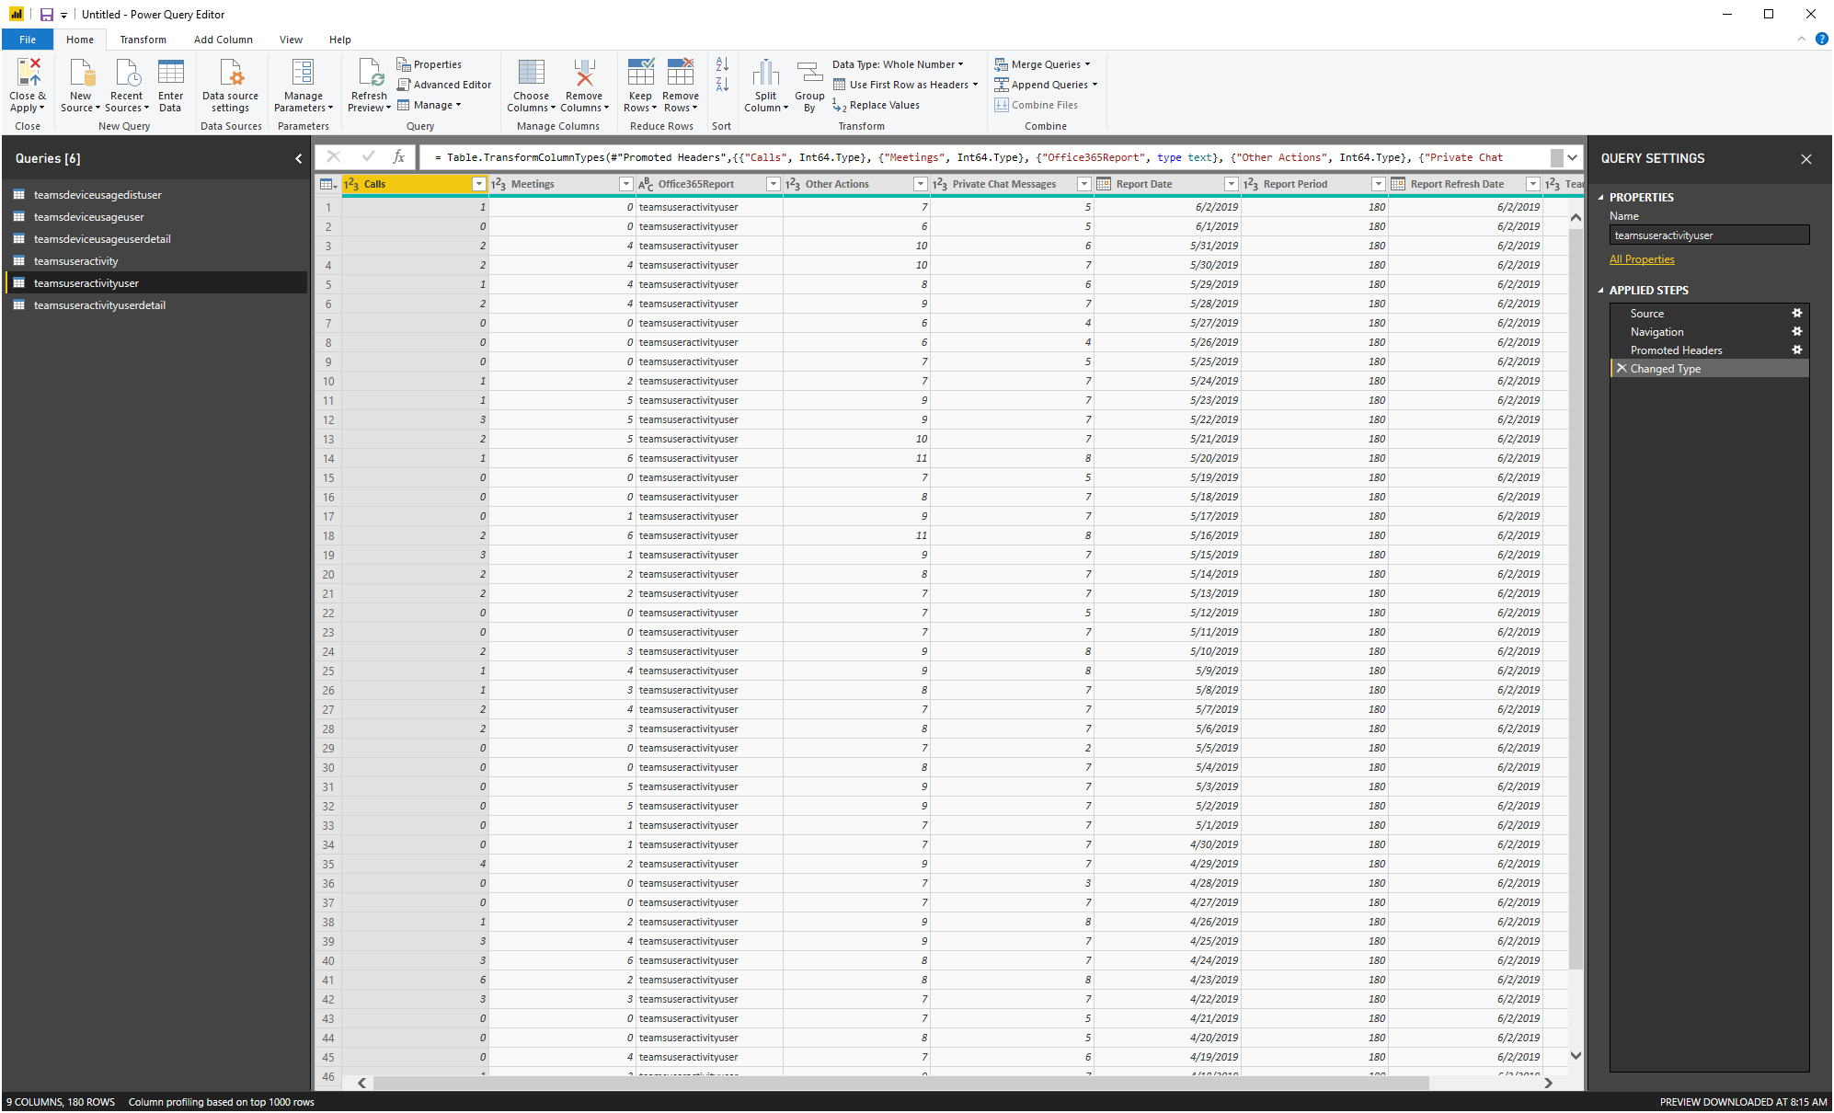
Power Query Editor

Slide 16
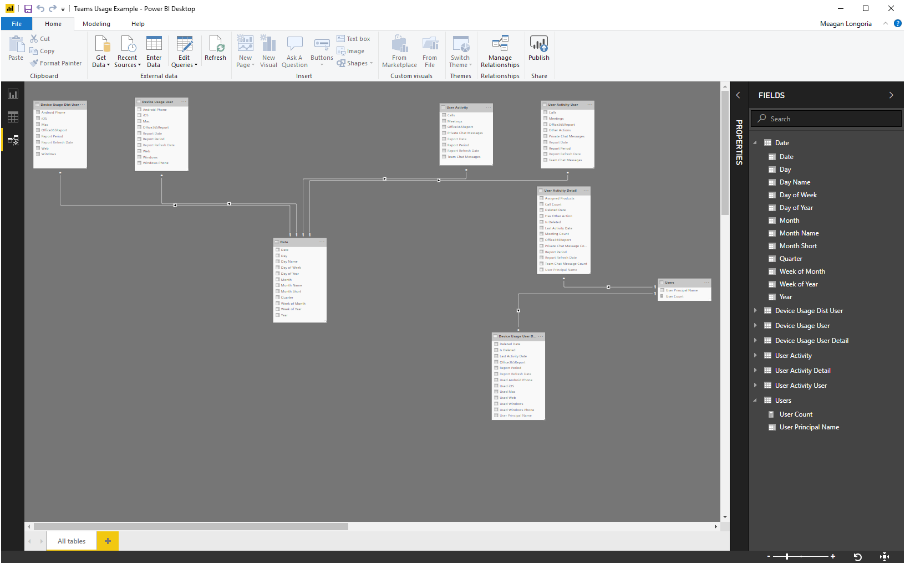
Relationships and Calculations

Slide 17
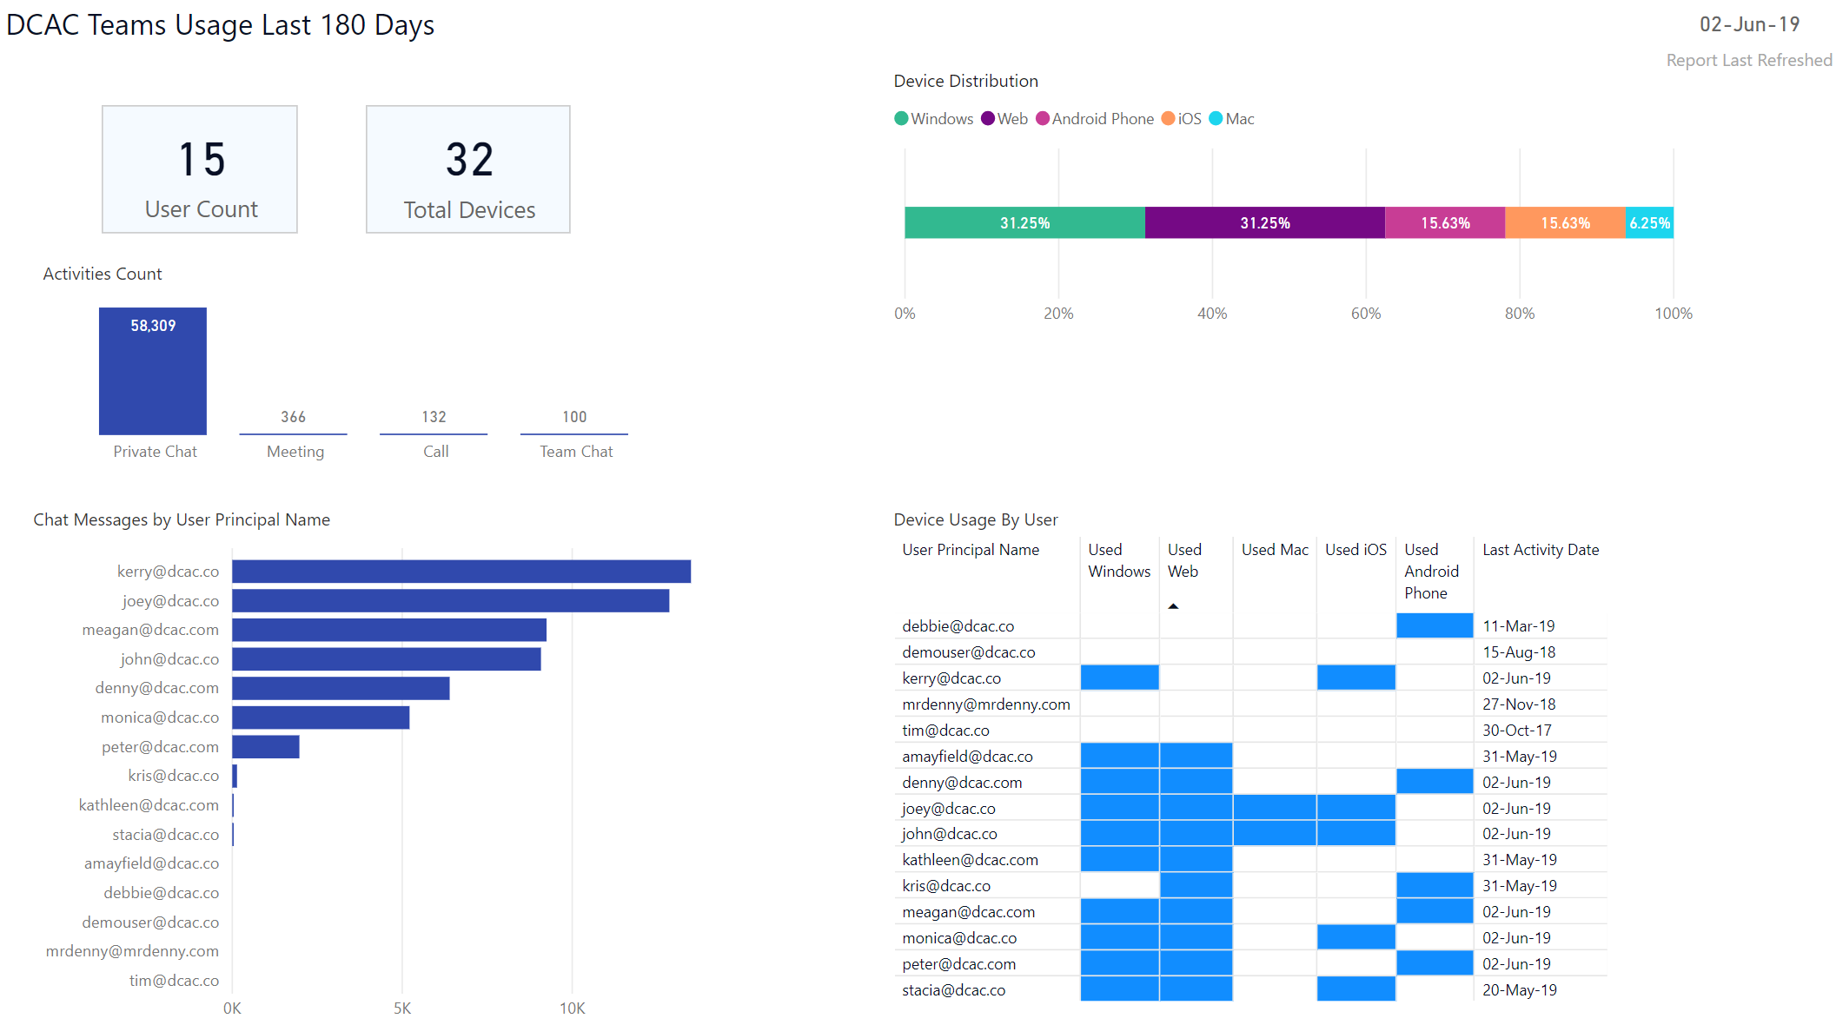
Report Pages

Slide 18
Deploying a Power BI Report
PBIX file is deployed to PowerBI.com
Dataset and report are separated
Set parameters and scheduled refresh
Build dashboards (essentially widget pages)
Map users principles to RLS roles
(Access is granted by the target workspace)

Slide 19
Demo
Put Power BI and Teams Together

Slide 20
Tips
Make sure you deploy to the appropriate workspace
Make sure users have access to the workspace
Use the tabbed conversations to keep things in context
Check out pre-built reports:
  Microsoft 365 Usage Analytics
  TyGraph

Slide 21
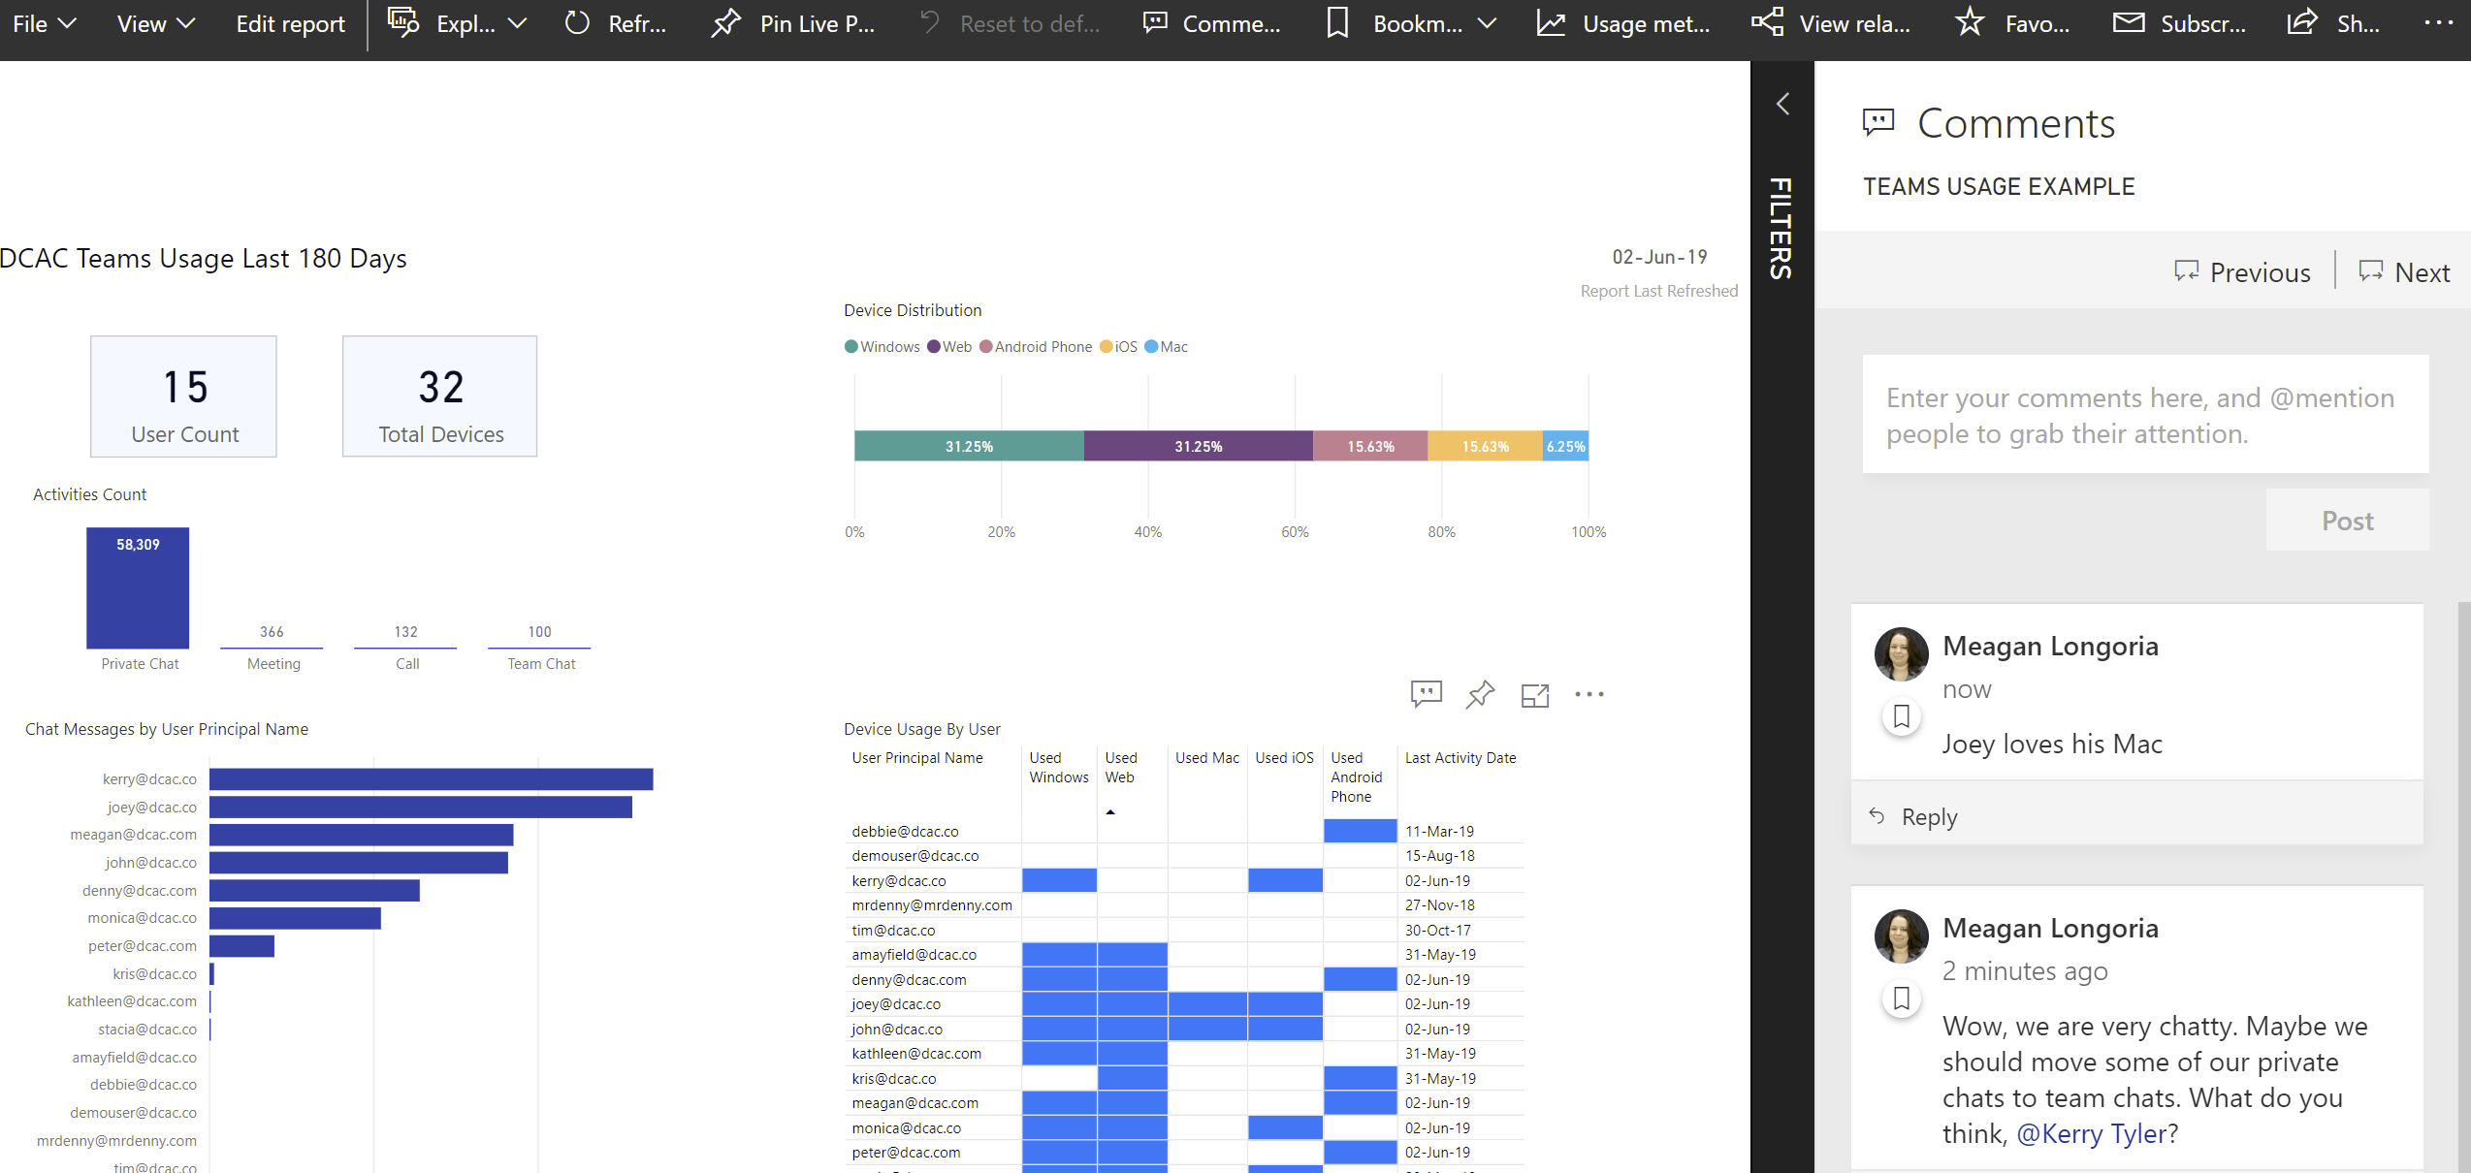
Comments in Power BI vs Teams
Power BI allows page and visual level comments
Power BI allows text (with links and mentions) only

Slide 22





Why Is Teams + Power BI Cool?
Cognitive Load
Limit of ~4 things at once
Rehearsal
Sensory Memory
Working Memory
Encoding
Long-term Memory
Incoming Information
Retrieval
Forgotten
Forgotten
Notes:
Teams can help reduce extraneous cognitive load

Slide 23























Thanks to our sponsors!
Gold Sponsors

Slide 24
Please Complete Evaluations
Provide feedback to the speakers and staff to help improve future events

Slide 25
Community Events
Local user groups – check out skypeug.com for info on local Skype for Business and Microsoft Teams user groups in your area.

Slide 26
Questions?
Meagan Longoria
Consultant, Denny Cherry & Associates
@mmarie
DataSavvy.Me

Slide 27



