Slide 1

What’s New In Power BI
Meagan Longoria
January 12, 2015

Slide 2


About Me
Meagan Longoria
Senior Solutions Consultant at
Co-organizer of Kansas City SQL Saturday
Blog: http://DataSavvy.wordpress.com
Twitter: @mmarie
LinkedIn: www.linkedin.com/in/meaganlongoria/

Slide 3

Who Are You?
What is your role: analyst, BI developer, other?
What industries are represented here?

Slide 4
What is Power BI?
Power BI Desktop tool, PowerBI.com, and Power BI mobile apps
Related But Separate:
Power Pivot, Get Data/Power Query, Power Map/3D Map, and Power View in Excel
Power Pivot and Power View in SharePoint

Slide 5
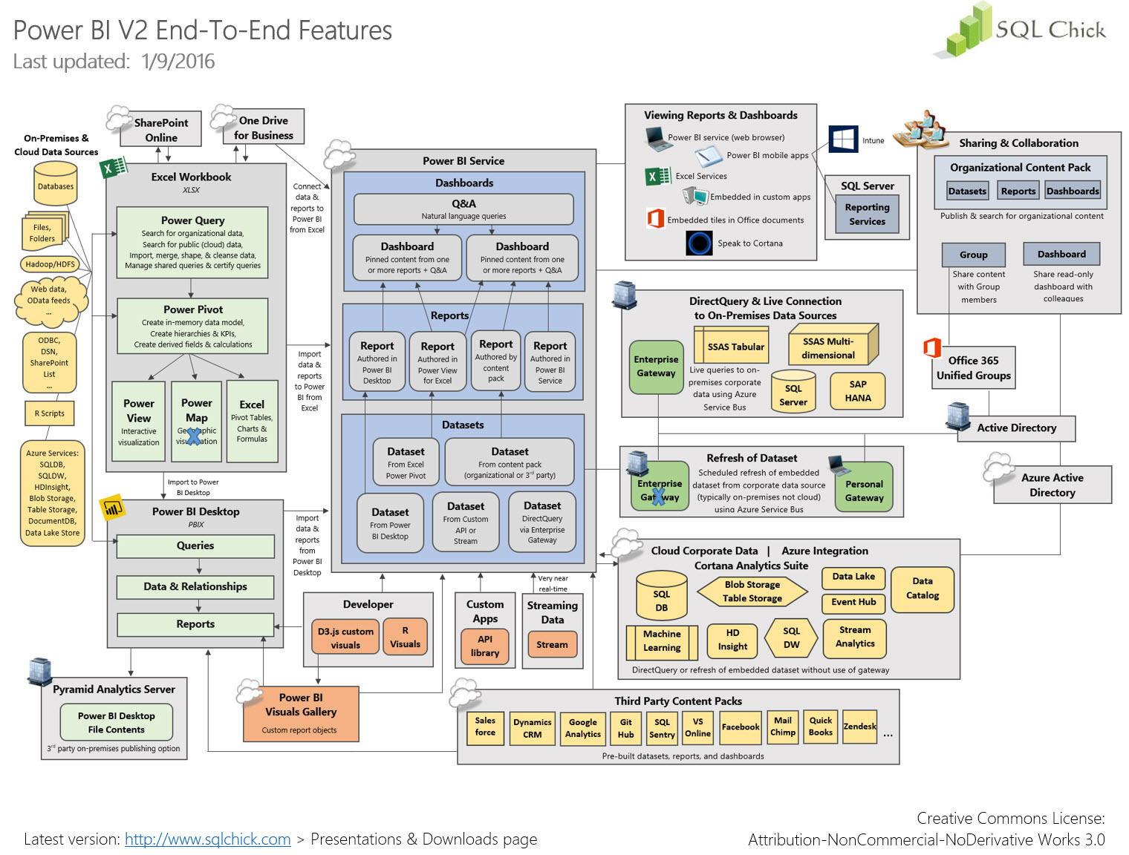

Slide 6
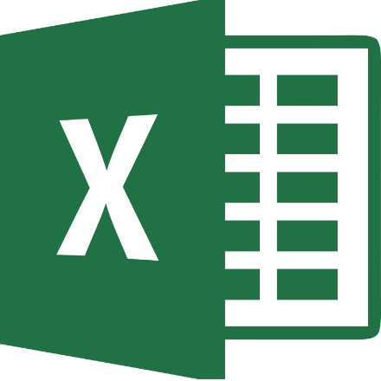


What’s New?
Excel 2016 – September 2015
SQL Server 2016
Different Release Cycles:
Power BI Desktop - monthly
Power BI Mobile - monthly
Power BI Service - weekly

Slide 7
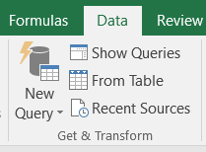
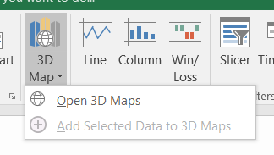

Excel 2016
Power Query functionality is now native Get & Transform Data (automate with VBA)
Power Map functionality is now 3D Maps, available in all versions
Measure icons and search the PivotTable fields list
PivotChart drilldown buttons
Publish to Power BI

Slide 8
Power Pivot for Excel 2016
Create/edit custom measures from PivotTable fields list
Improved arrows/lines in diagram view
Smart rename (formula fix-up)
More readable data view
Calendar function
Automatic relationship detection
Bi-directional filters
New DAX functions
DAX variables

Slide 9
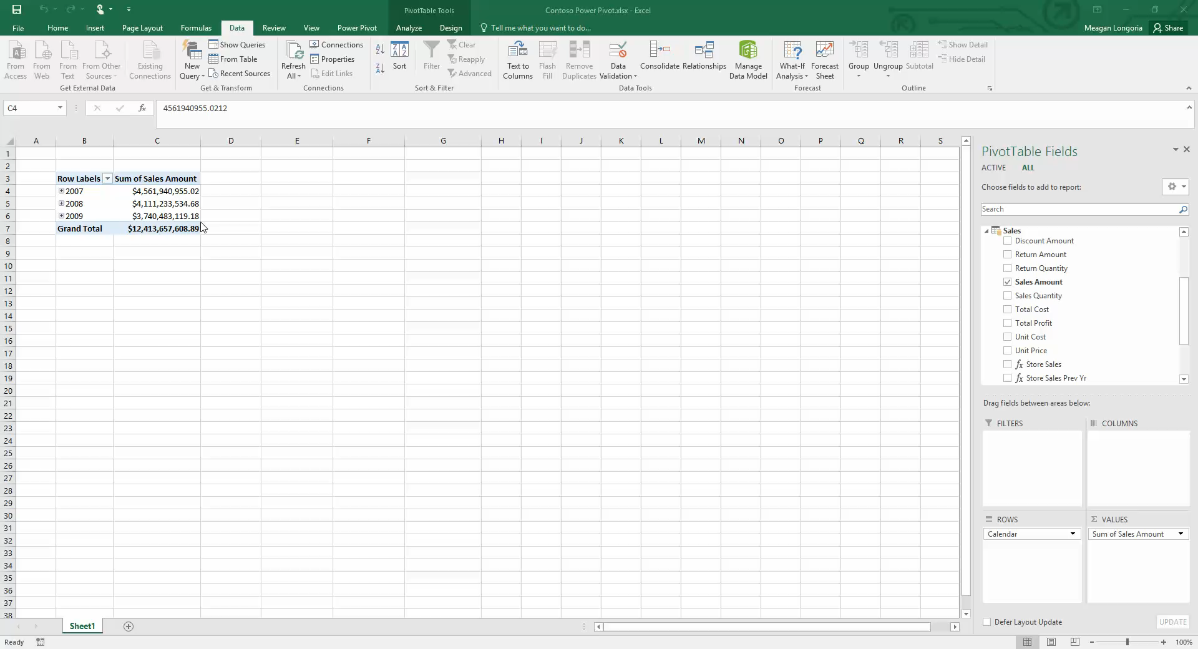
Demo

Slide 10
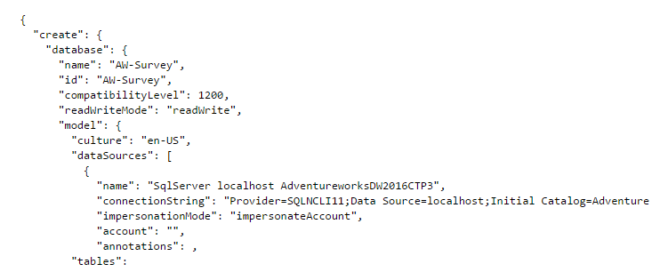
SQL Server Analysis Services 2016
Tabular Model Scripting Language (no server needed)
Smart rename/formula fix-up
Calculated Tables
Improved formula editing
DAX variables
Bi-directional filters
New DAX functions
Direct Query for Oracle, Teradata, and MS Analytics Platform

Slide 11
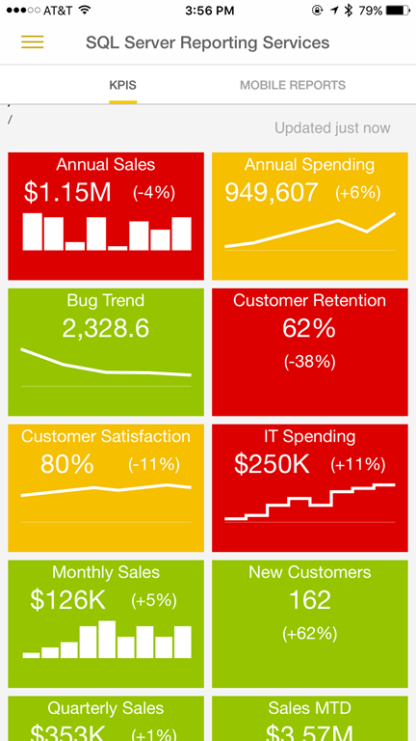
SQL Server Reporting Services 2016
Host mobile (Datazen) reports on a local report server and view in Power BI mobile apps
Publish interactive (Power BI) reports to SSRS report server (coming soon)

Slide 12


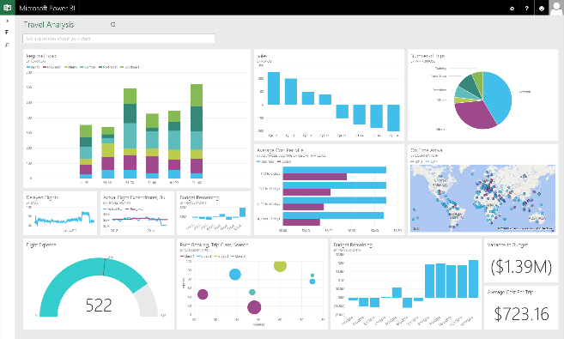

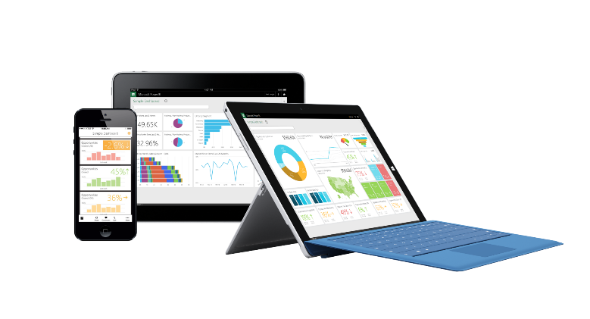
Power BI Overview
Business analyst tools
Microsoft cloud
Web browser
HTML
Power BI
Power BI Designer
Azure data
services
Office 365
Non Microsoft cloud software systems
(e.g., SaaS applications,
IOT scenarios, and data streams)
SQL Server
analysis services
iOS
Databases and
other data sources
Dynamics
Partner apps
On-premises data
Microsoft cloud
Non-Microsoft cloud
Mobile apps

Slide 13
Power BI Desktop
R Visuals
R scripts
Visual layout (alignment, distribute, size, position)
Duplicate pages
Control z-order
Format painter
Horizontal slicers
Automatic Date Features
Paste/enter data to create table

Slide 14
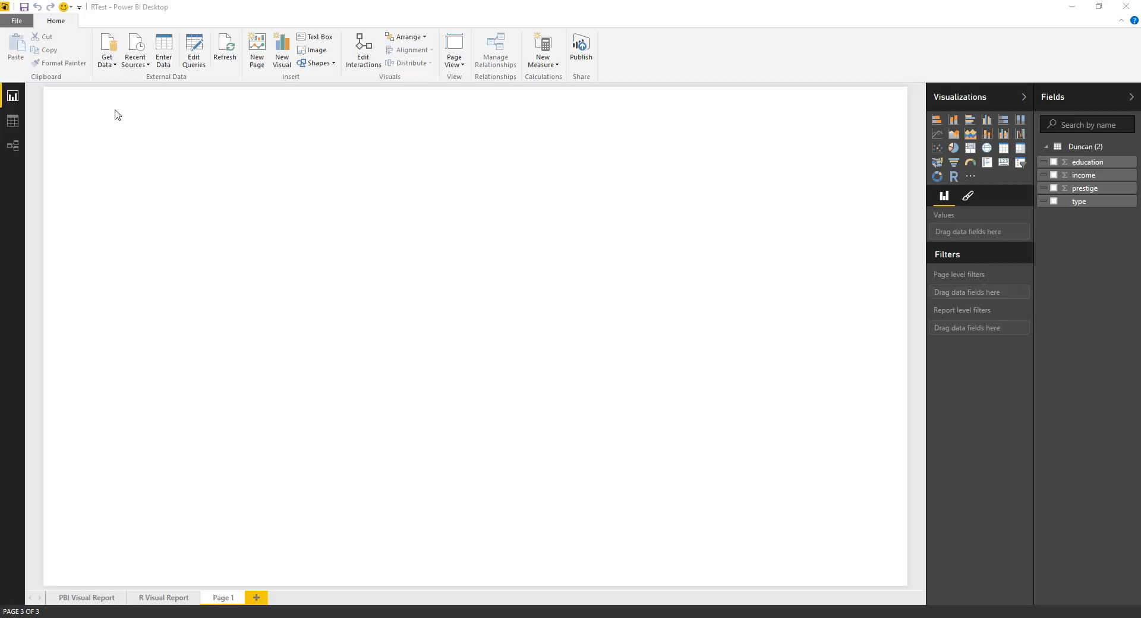
Desktop Demo

Slide 15
Power BI Service
Reference line
Quick Insights
Export dashboard tile or report visual data
Pin Excel ranges and charts to dashboards
Pin report page to dashboard
Visual layout (alignment, distribute, size, position)
R connector and visuals
Print report pages and dashboards
Power BI enterprise gateway

Slide 16
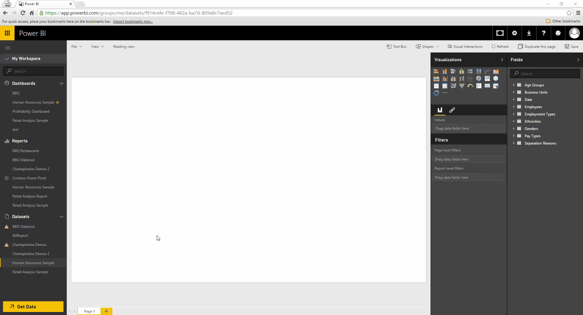
Power BI Service Demo

Slide 17
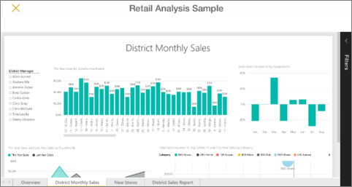
Power BI Mobile
Mobile support for pinned report pages
Mobile SSRS (Datazen) reports in Power BI app
Windows 10 mobile app

Slide 18
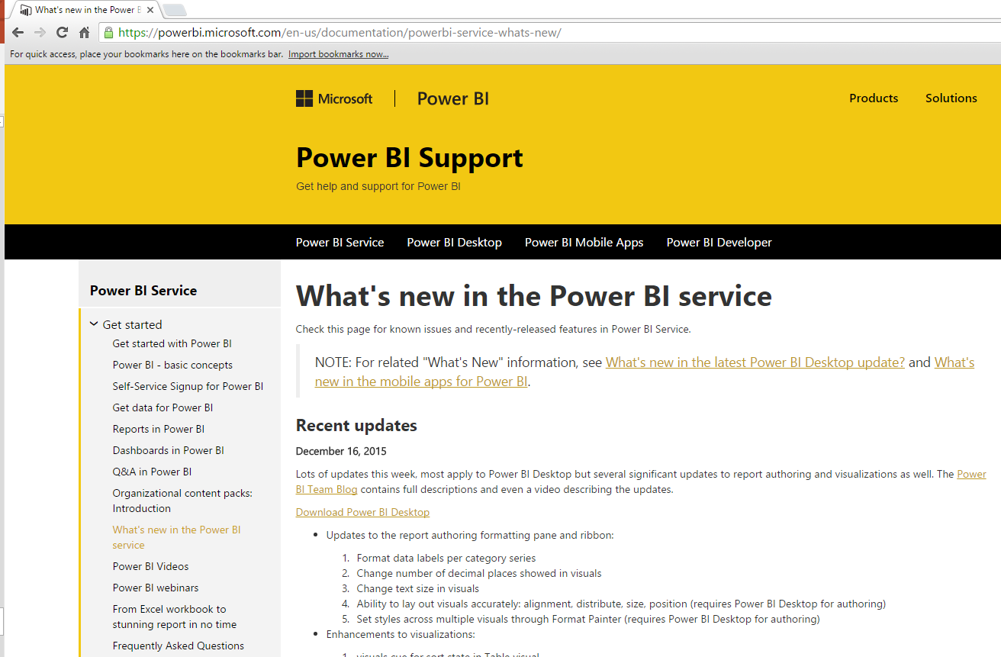
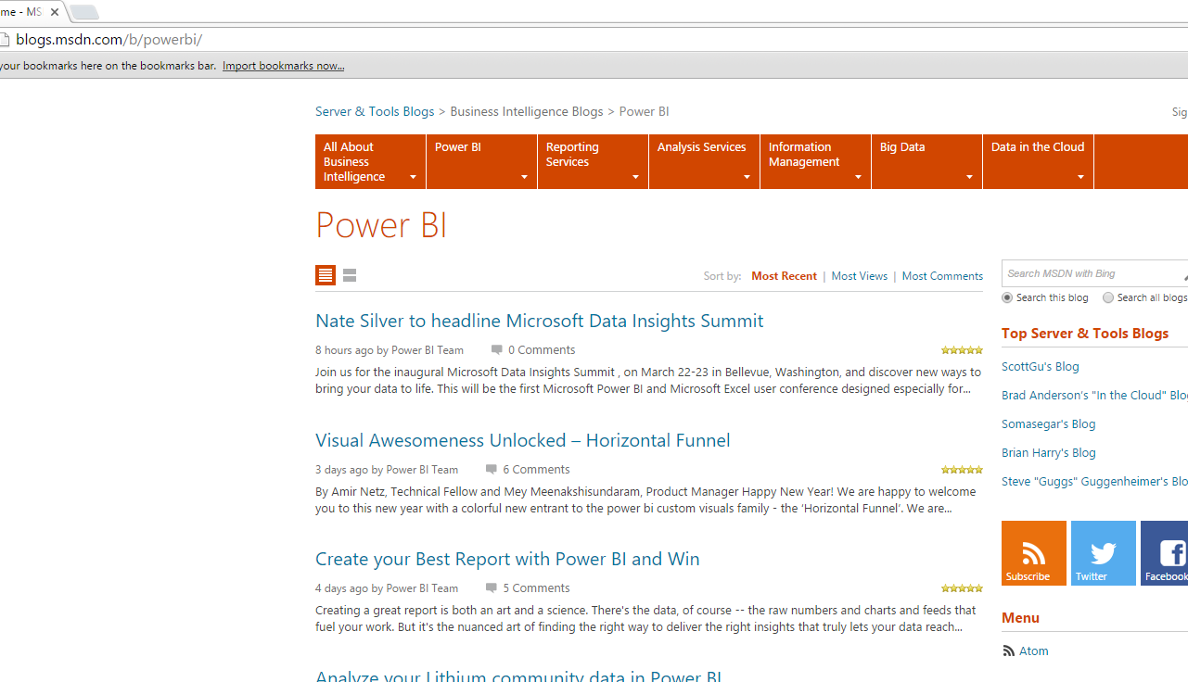
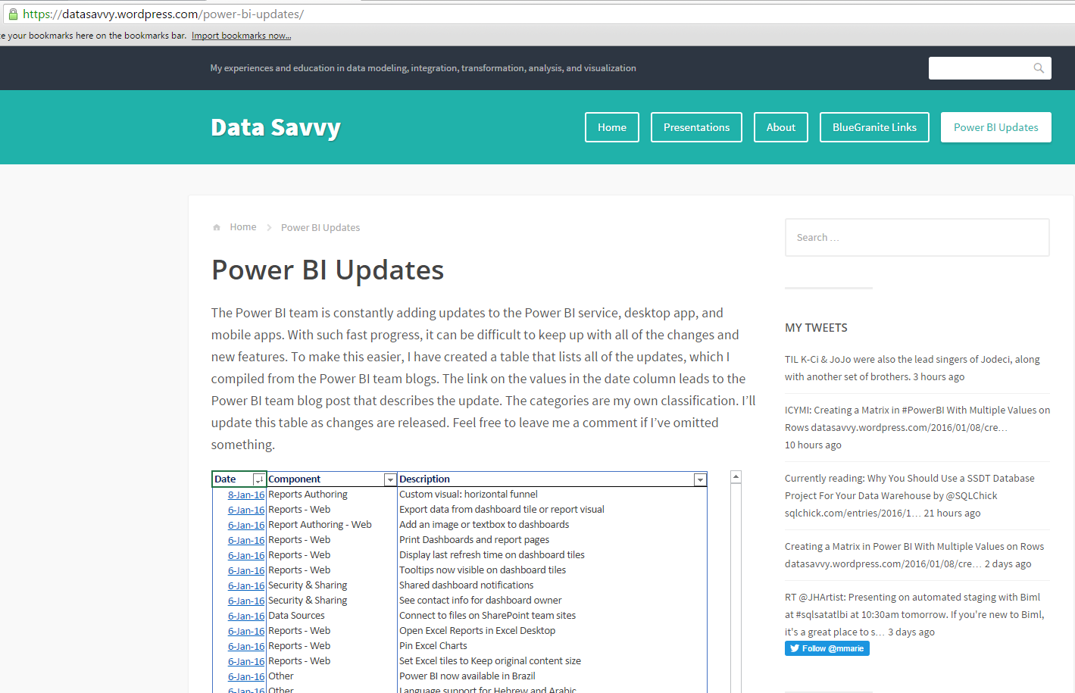
How To Keep Up
What’s New In Power BI pages
Power BI Blog
Power BI Updates List (my blog)

Slide 19
For More Information
What‘s New In Excel 2016: https://support.office.com/en-ca/article/What-s-new-in-Excel-2016-for-Windows-5fdb9208-ff33-45b6-9e08-1f5cdb3a6c73
Excel 2016: 10 Heartwarming Improvements: http://www.powerpivotpro.com/2015/07/excel-2016-heartwarming-improvements/
Excel 2016's New & Improved Features: http://www.cimaglobal.com/Thought-leadership/Newsletters/Insight-e-magazine/Insight-2015/Insight-October-2015/Excel-2016s-new-and-improved-features-part-one/
New DAX Functions in Excel 2016: https://support.office.com/en-in/article/New-DAX-functions-8192a787-aa91-4d7f-9a82-4e2c607e629a
What‘s New In SSAS 2016: https://msdn.microsoft.com/en-us/library/bb522628.aspx
MS Reporting Roadmap: http://blogs.technet.com/b/dataplatforminsider/archive/2015/10/29/microsoft-business-intelligence-our-reporting-roadmap.aspx

Slide 20
More Information
Power BI Diagram by Melissa Coates: http://www.sqlchick.com/entries/2015/9/29/overview-power-bi-v2-features-end-to-end
What‘s New In Power BI Desktop: https://powerbi.microsoft.com/en-us/documentation/powerbi-desktop-latest-update/
What‘s New In Power BI Mobile: http://blogs.msdn.com/b/powerbi/archive/2015/11/24/power-bi-mobile-apps-update-_2d00_-november-2015.aspx
Deploying SQL 2016 Power Pivot/View to SharePoint: http://blogs.msdn.com/b/analysisservices/archive/2015/12/08/white-paper-published-deploying-sql-server-2016-powerpivot-and-power-view-in-sharepoint-2016.aspx
Getting Started With R Visuals in Power BI: http://sqldusty.com/2015/12/30/getting-started-with-r-visuals-in-power-bi/
Power BI Updates List: https://datasavvy.wordpress.com/power-bi-updates/

Slide 21

Questions/Comments
Meagan Longoria
DataSavvy.wordpress.com
@mmarie
Blue-Granite.com

